Slide 1
Online
Baking System
Team members:
Kariem Abdelmoniem
Abdelrahman Mohamed
Ahmed Mohamed Nabil
Bassem Baraket-allah

Slide 2
Table of contents
01
02
INTRODUCTION
Project Goals & Objectives:
03
04
Technology Stack
User Interface (UI)
05
System Architecture

Slide 3
Introduction
Our project is an online shopping platform facilitating user registration and login for customers, administrators, and delivery personnel. It offers comprehensive product management, seamless shopping cart functionality, and efficient order processing, ensuring a user-friendly experience and effective feedback collection for continuous improvement.

Slide 4

Project Goals & Objectives:
Create an functional bakery online shopping platform for all users.
Optimize processes for efficiency and effective management.
Gather feedback for continuous improvement.
Design a scalable and secure infrastructure.

Slide 5
Technology Stack
1 - Frontend :
HTML/CSS/JavaScript: For building the user interface and handling client-side interactions.
2 - Backend :
ASP.NET Core: A cross-platform for building web API
C#: A versatile and powerful programming language
Entity Framework Core: An ORM framework
Database: Sql Server
3 -Authentication & Authorization:
JSON Web Tokens (JWT): For securely transmitting information between parties as a JSON object.
4 -Version Controlling :
Git & GitHub

Slide 6
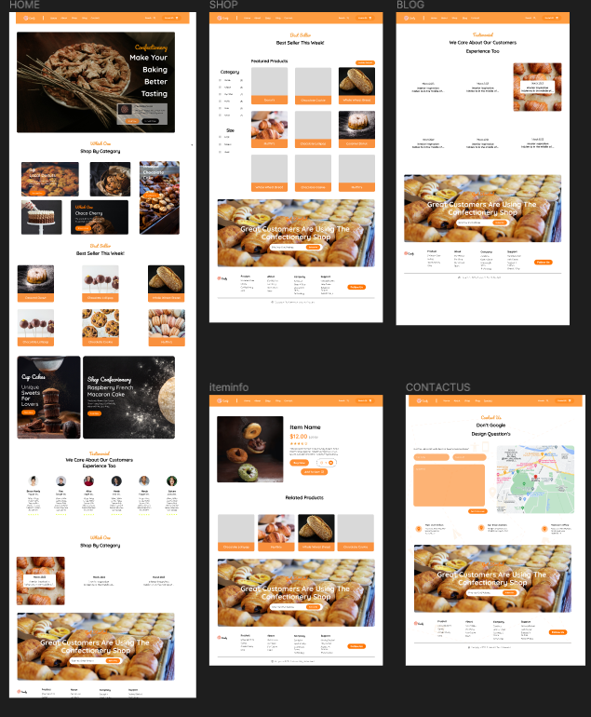
User Interface (UI)

Slide 7
System Architecture
2. Application Layer:
Logic tier handling business processes.
Modules include authentication, product management, order processing .
Implemented using ASP.NET for backend logic.
3. Data Layer:
Stores persistent data such as customer details, product inventory, and orders.
Includes a relational database (sql server)
Presentation Layer:
User interfaces for customers and bakery staff.
Implemented using HTML, CSS, and JavaScript.
Interaction Between Components:
Customers interact with the presentation layer, which sends requests to the application layer.
The application layer processes requests, interacts with the data layer, and sends responses back to the presentation layer.
This architecture ensures scalability, maintainability, and security for our online bakery system.

Slide 8
THANKS!
Do you have any questions?

